Slide 1
Cross-Site Request Forgery Attack
By Tyler Rollinson

Slide 2
What is it?
Cross-Site Request Forgery (CSRF) is an attack that forces an end user to execute unwanted actions on a web application in which they’re currently authenticated. A compromised link is all that is needed to gain the ability to force the actions.

Slide 3
How it works
The target user is running a session with a trusted site, for this example say a bank site. The user then goes to a malicious site while still logged in. The malicious site then injects a HTTP request for the trusted site into the user's session. From there money transfers, and password changes can occur.

Slide 4
Lab Tasks
Set-up the containers
Observe the HTTP Request
Use a CSRF attack using GET request
Use a CSRF attack using a POST request
Enabling countermeasures to protect from an attack
Experiment with SameSite Cookie Method

Slide 5
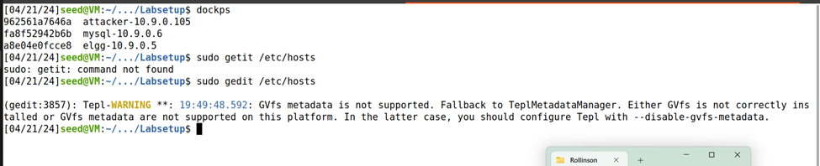
Container Set-up
I used dcup to create the three containers needed for the set -p of this lab.
The attacker container is used host the malicious website.
The elgg container is used to host a web-based social networking application.

Slide 6
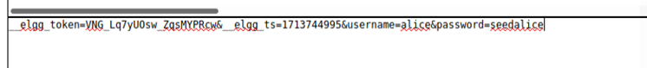
Observing HTTP Request
I used a Firefox add-on called "HTTP Header Live" to observe what a legitimate HTTP header's parameters look like. Once you get the actual HTTP header, you can then alter it to gain access to accounts.

Slide 7
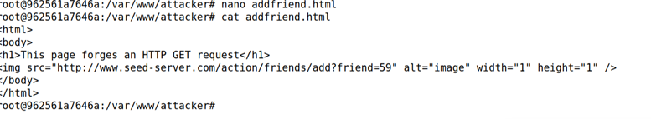
Task 3.2 CSRF Attack using a GET Request
The attack is focused on using a CSRF attack GET request to become the target Alice's friend.
This shows that Alices add friend number is changed from 56 to Samy’s 59 as shown on line 6. Once the new source code is changed the website is opened and allows the friend request to be accepted.

Slide 8
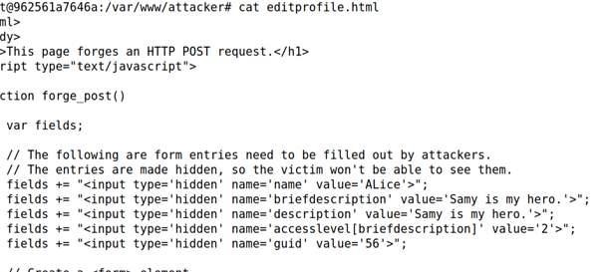
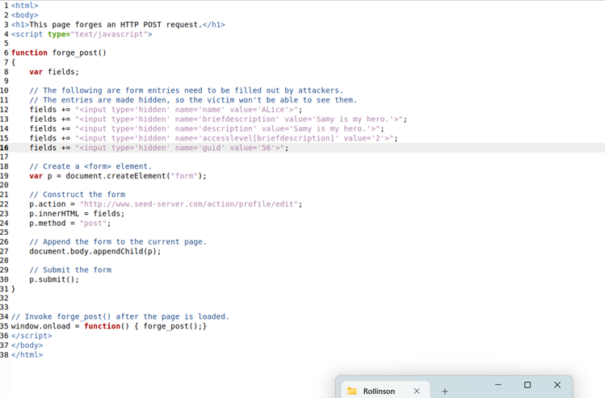



Task 3.3 Using A CSRF Attack using a POST Request
In this task I edited Alice's profile after I gained access and became friends with her through Samy's account. This is through forging the HTTP POST Request.

Slide 9
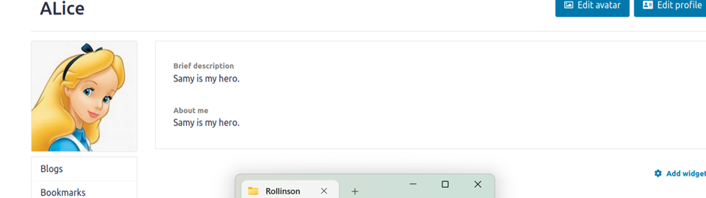
Task 3.3 Continued
This screenshot shows the results after the attack was successful.

Slide 10
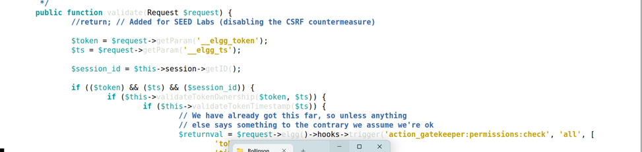

Task 4.1 Defense
I added a countermeasure that adds a secret token and time stamp to the web page to defend against a CSRF attack like the ones I just did. Elgg uses this type of countermeasure to defend against this type of attack and to track .

Slide 11
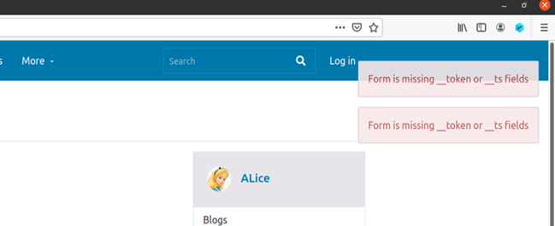
4.1 Defense Continued
This shows that the countermeasures were implemented correctly and work to prevent this type of attack.

Slide 12
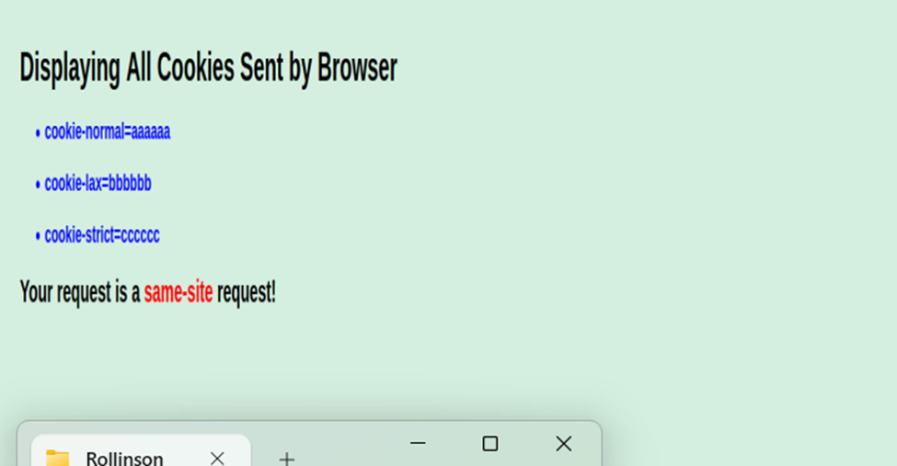
Experimenting With Same-Site cookies
Same-Site cookies and secret tokens are essential security measures against CSRF attacks. Same-Site cookies restrict cookie transmission in cross-site requests, while secret tokens add an extra layer of verification.

Slide 13

Challenges
During the lab, I took a break for and when I came back my Virtual Machine froze, and I had to re start the containers.
No other challenges were faced.

Slide 14
Questions

